Slide 1
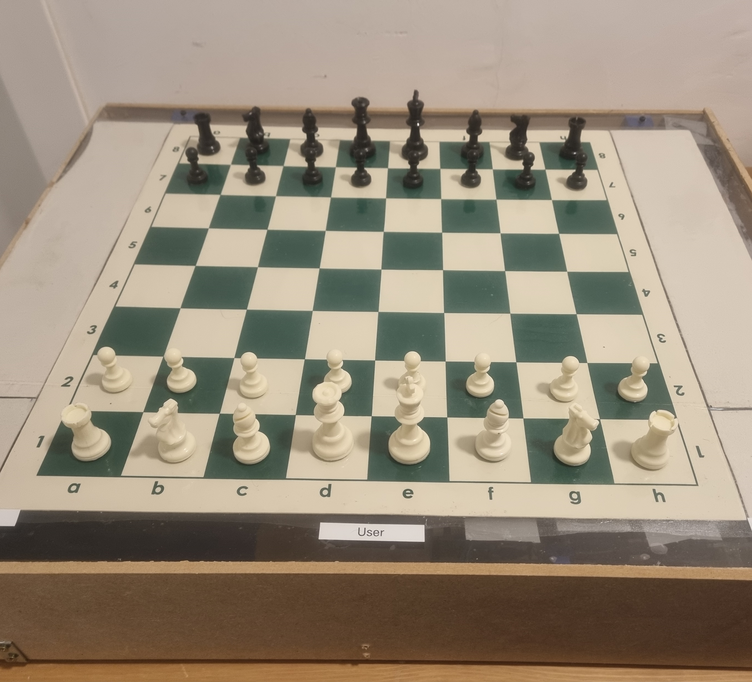
AutoChess Project
23/09/2022

Slide 2
AutoChess Project Demo
https://www.youtube.com/watch?v=uHLaz7CAxSU&ab_channel=YakirShlezinger

Slide 3
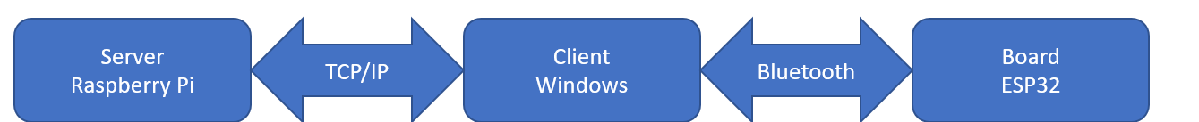
AutoChess Architecture
AutoChess project contain 3 main components:
Server In charge of managing users, games and clients communications.
Client Middleman between the server and the board and the main user interface.
Board In charge of pieces movement and move detection.

Slide 4

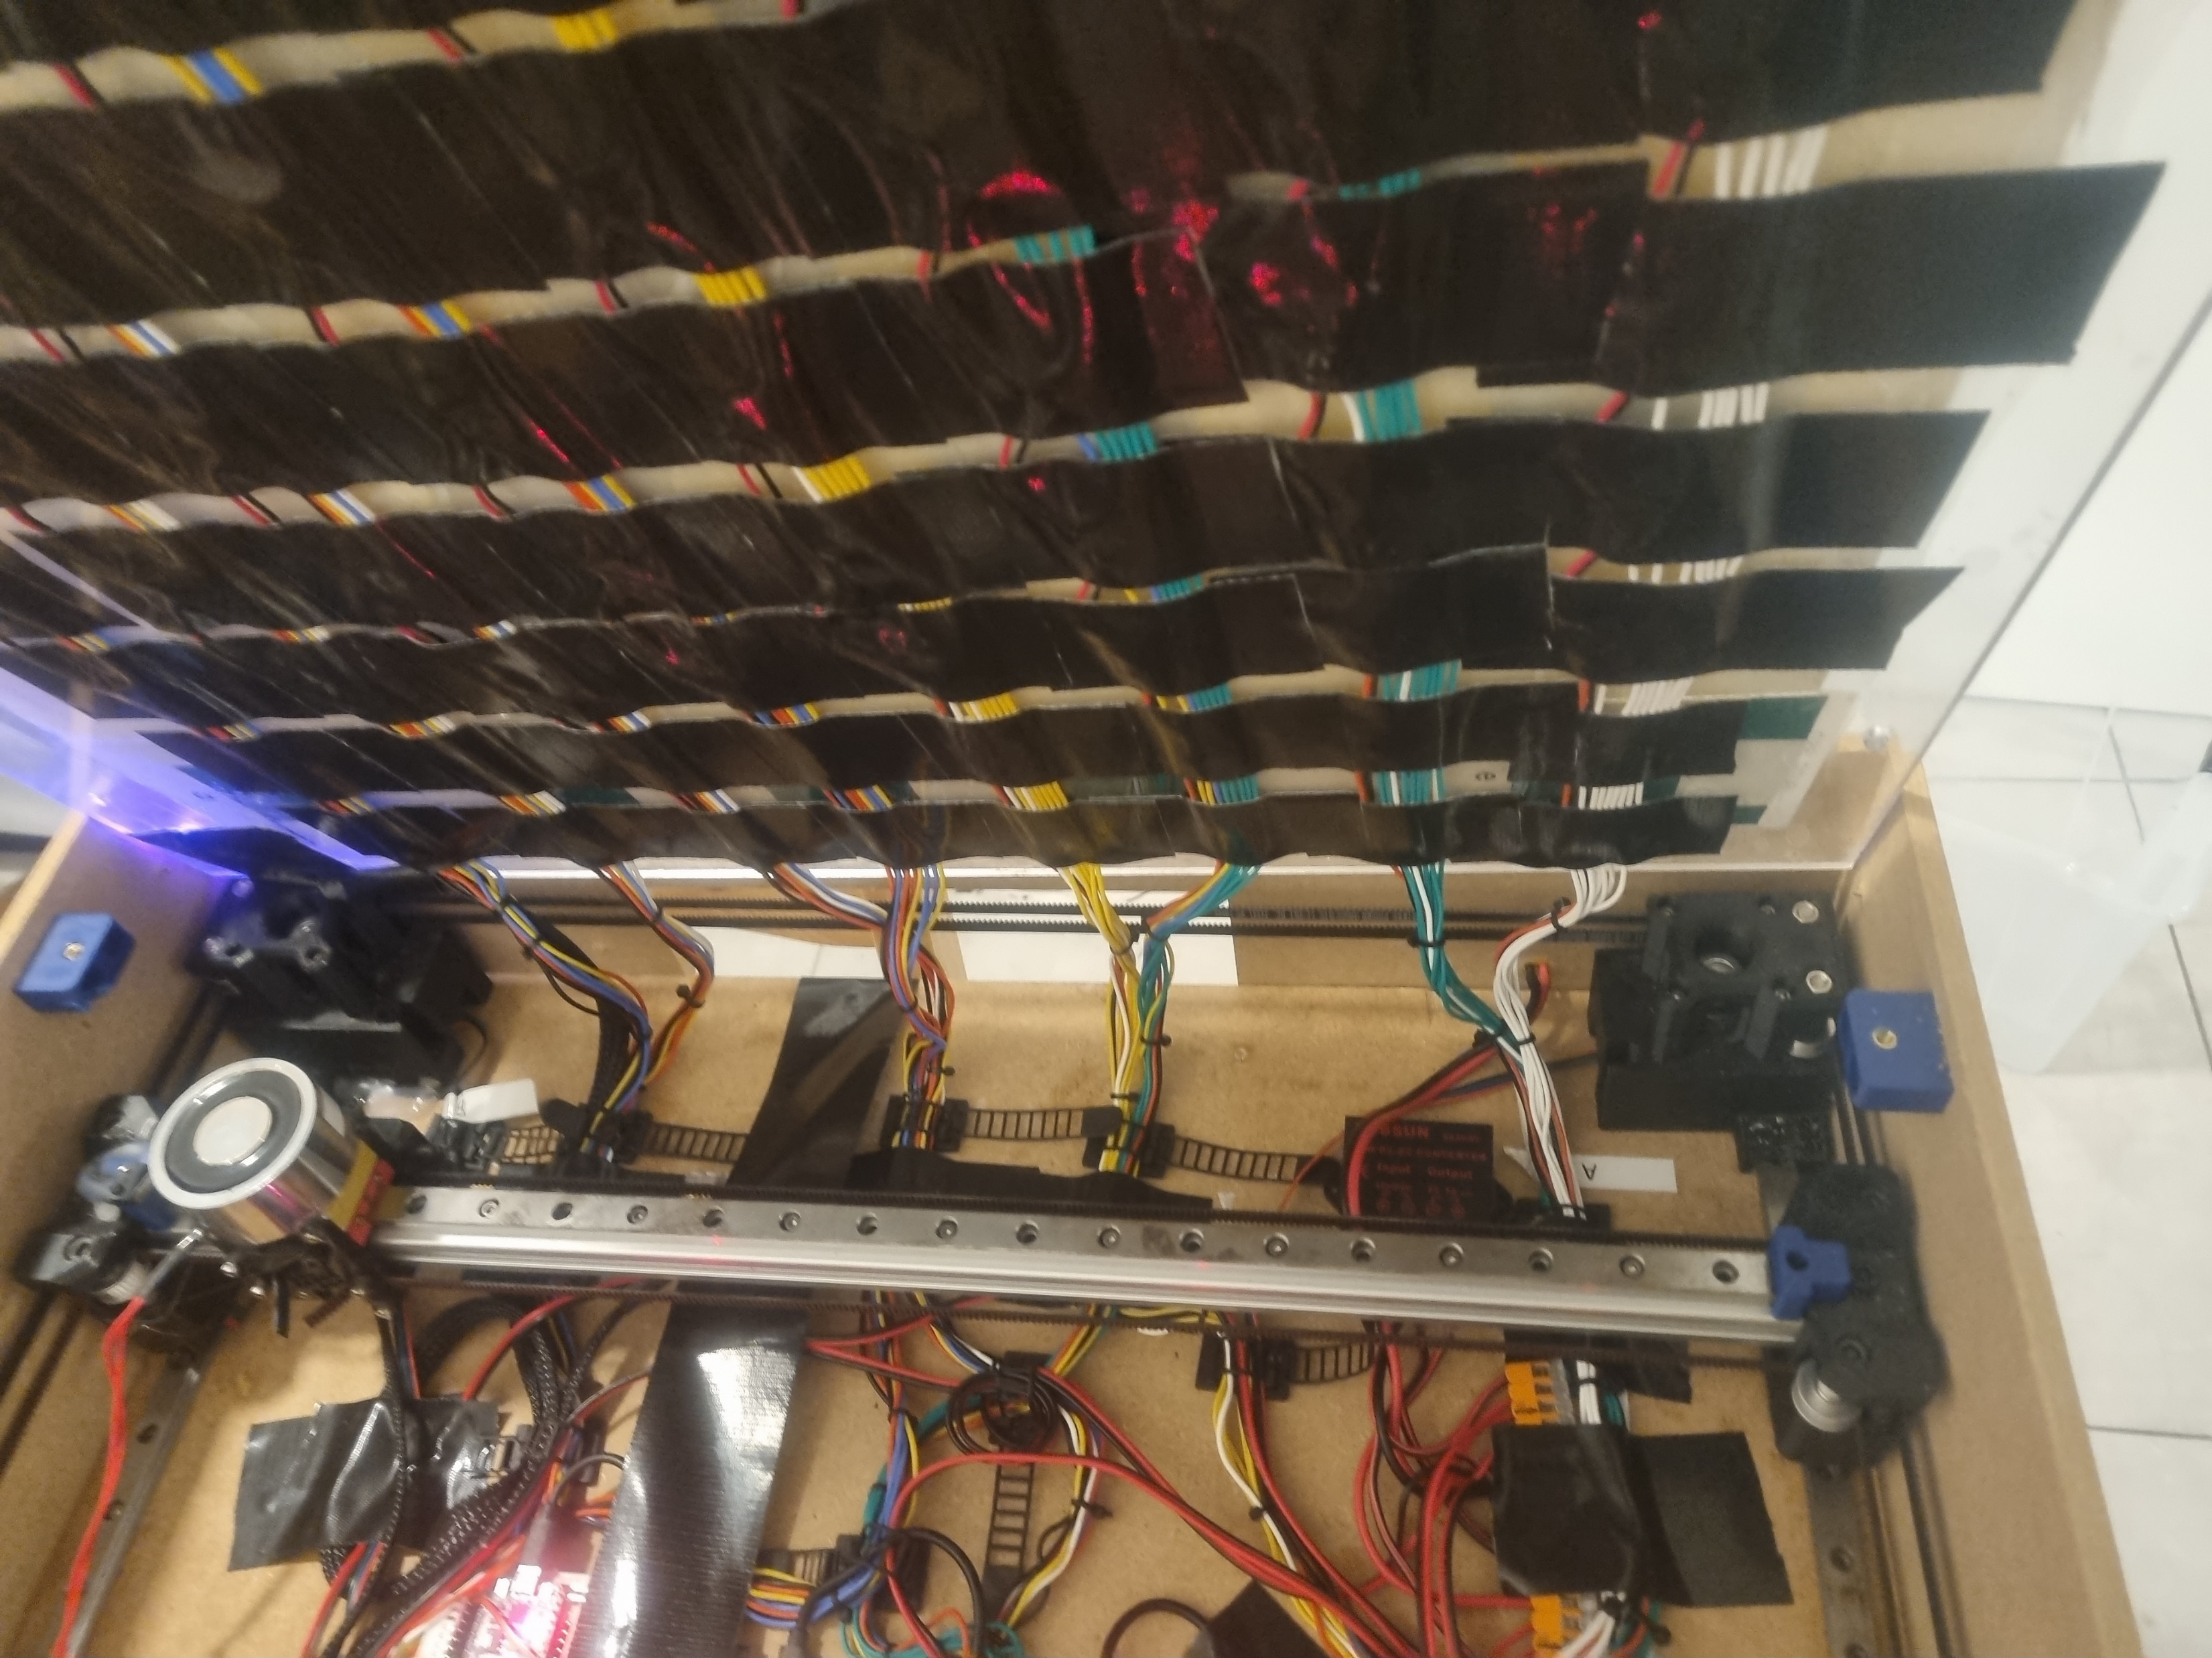
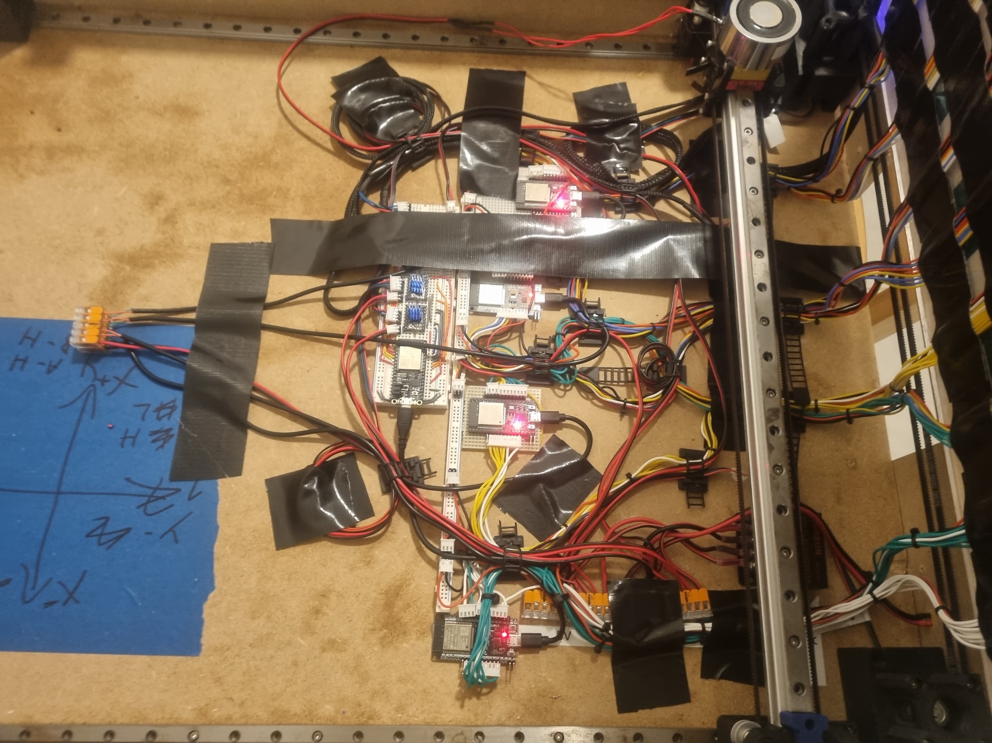
Board
Board jobs:
Board Client communications (via Bluetooth).
Opponent pieces movement.
User movement detection.
Main MCU: ESP32-WROOM-32
Secondary MCUs: 4 ESP32-WROOM-32
MCU programming language: C

Slide 5
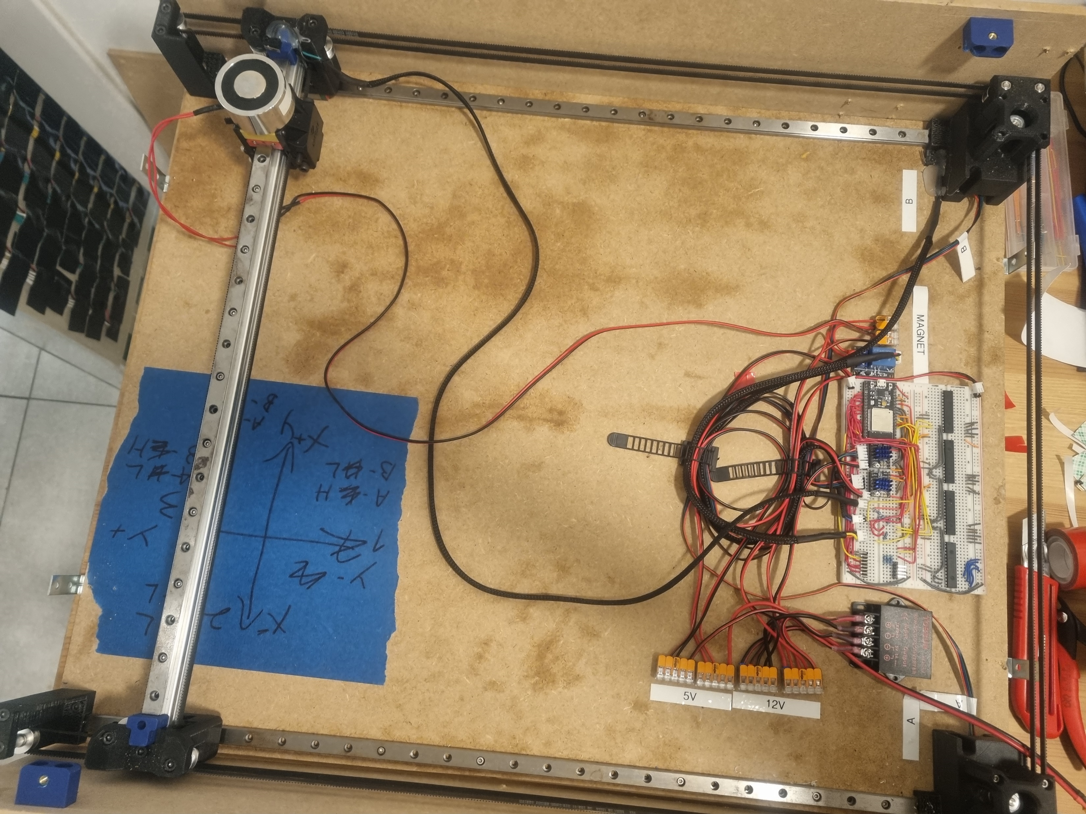
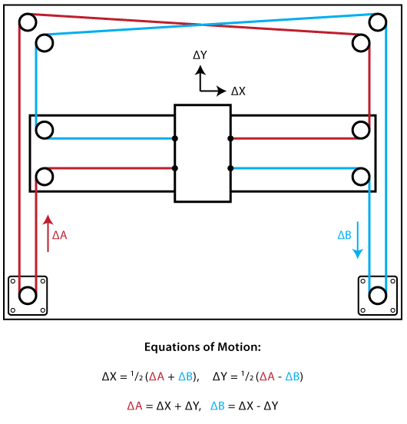
Board – Pieces movement
Moving the chess pieces is done by magnetic forces:
Every chess piece have a magnet on the bottom.
The board contain a moving electromagnet (x-y plane)
The MCU is moving the electromagnet in x-y plane using CoreXY Kinemtic
Both stepper motors (A & B) are static.
Motors are connected using TMC2209 Drivers.
The gantry assembly using:
2 Motors.
Several pulleys.
2 Timing belts.
3 Linear Rails.
3D printed brackets.
A Motor
B Motor
Electromagnet

Slide 6
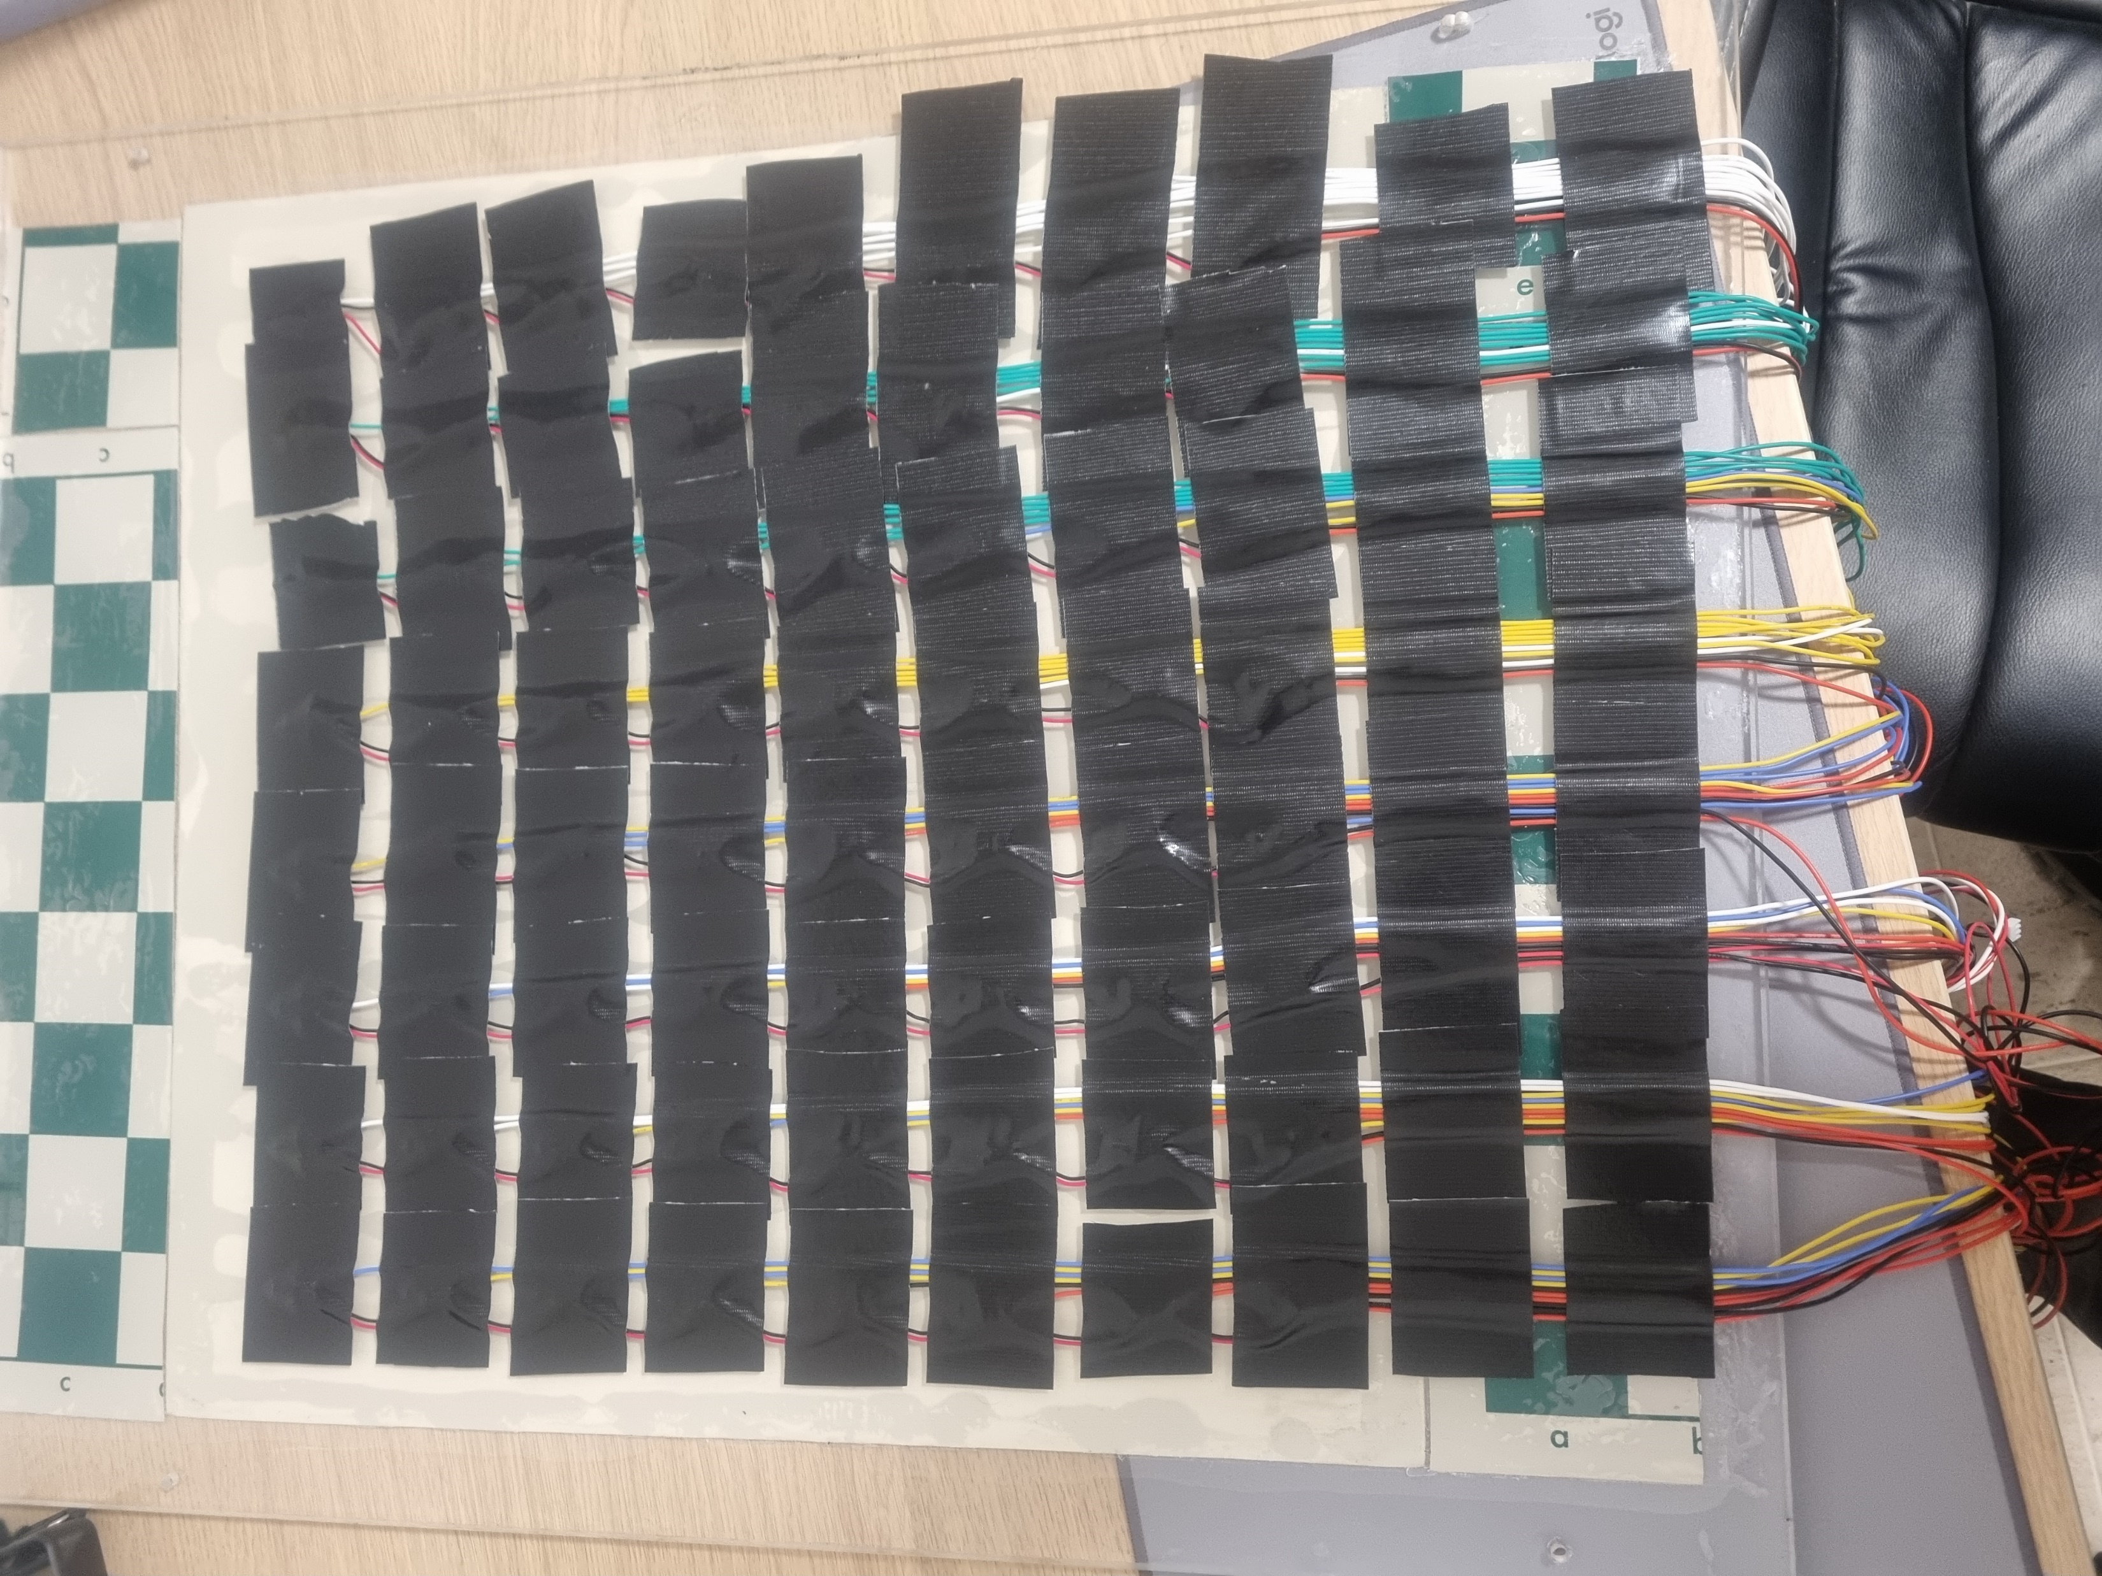
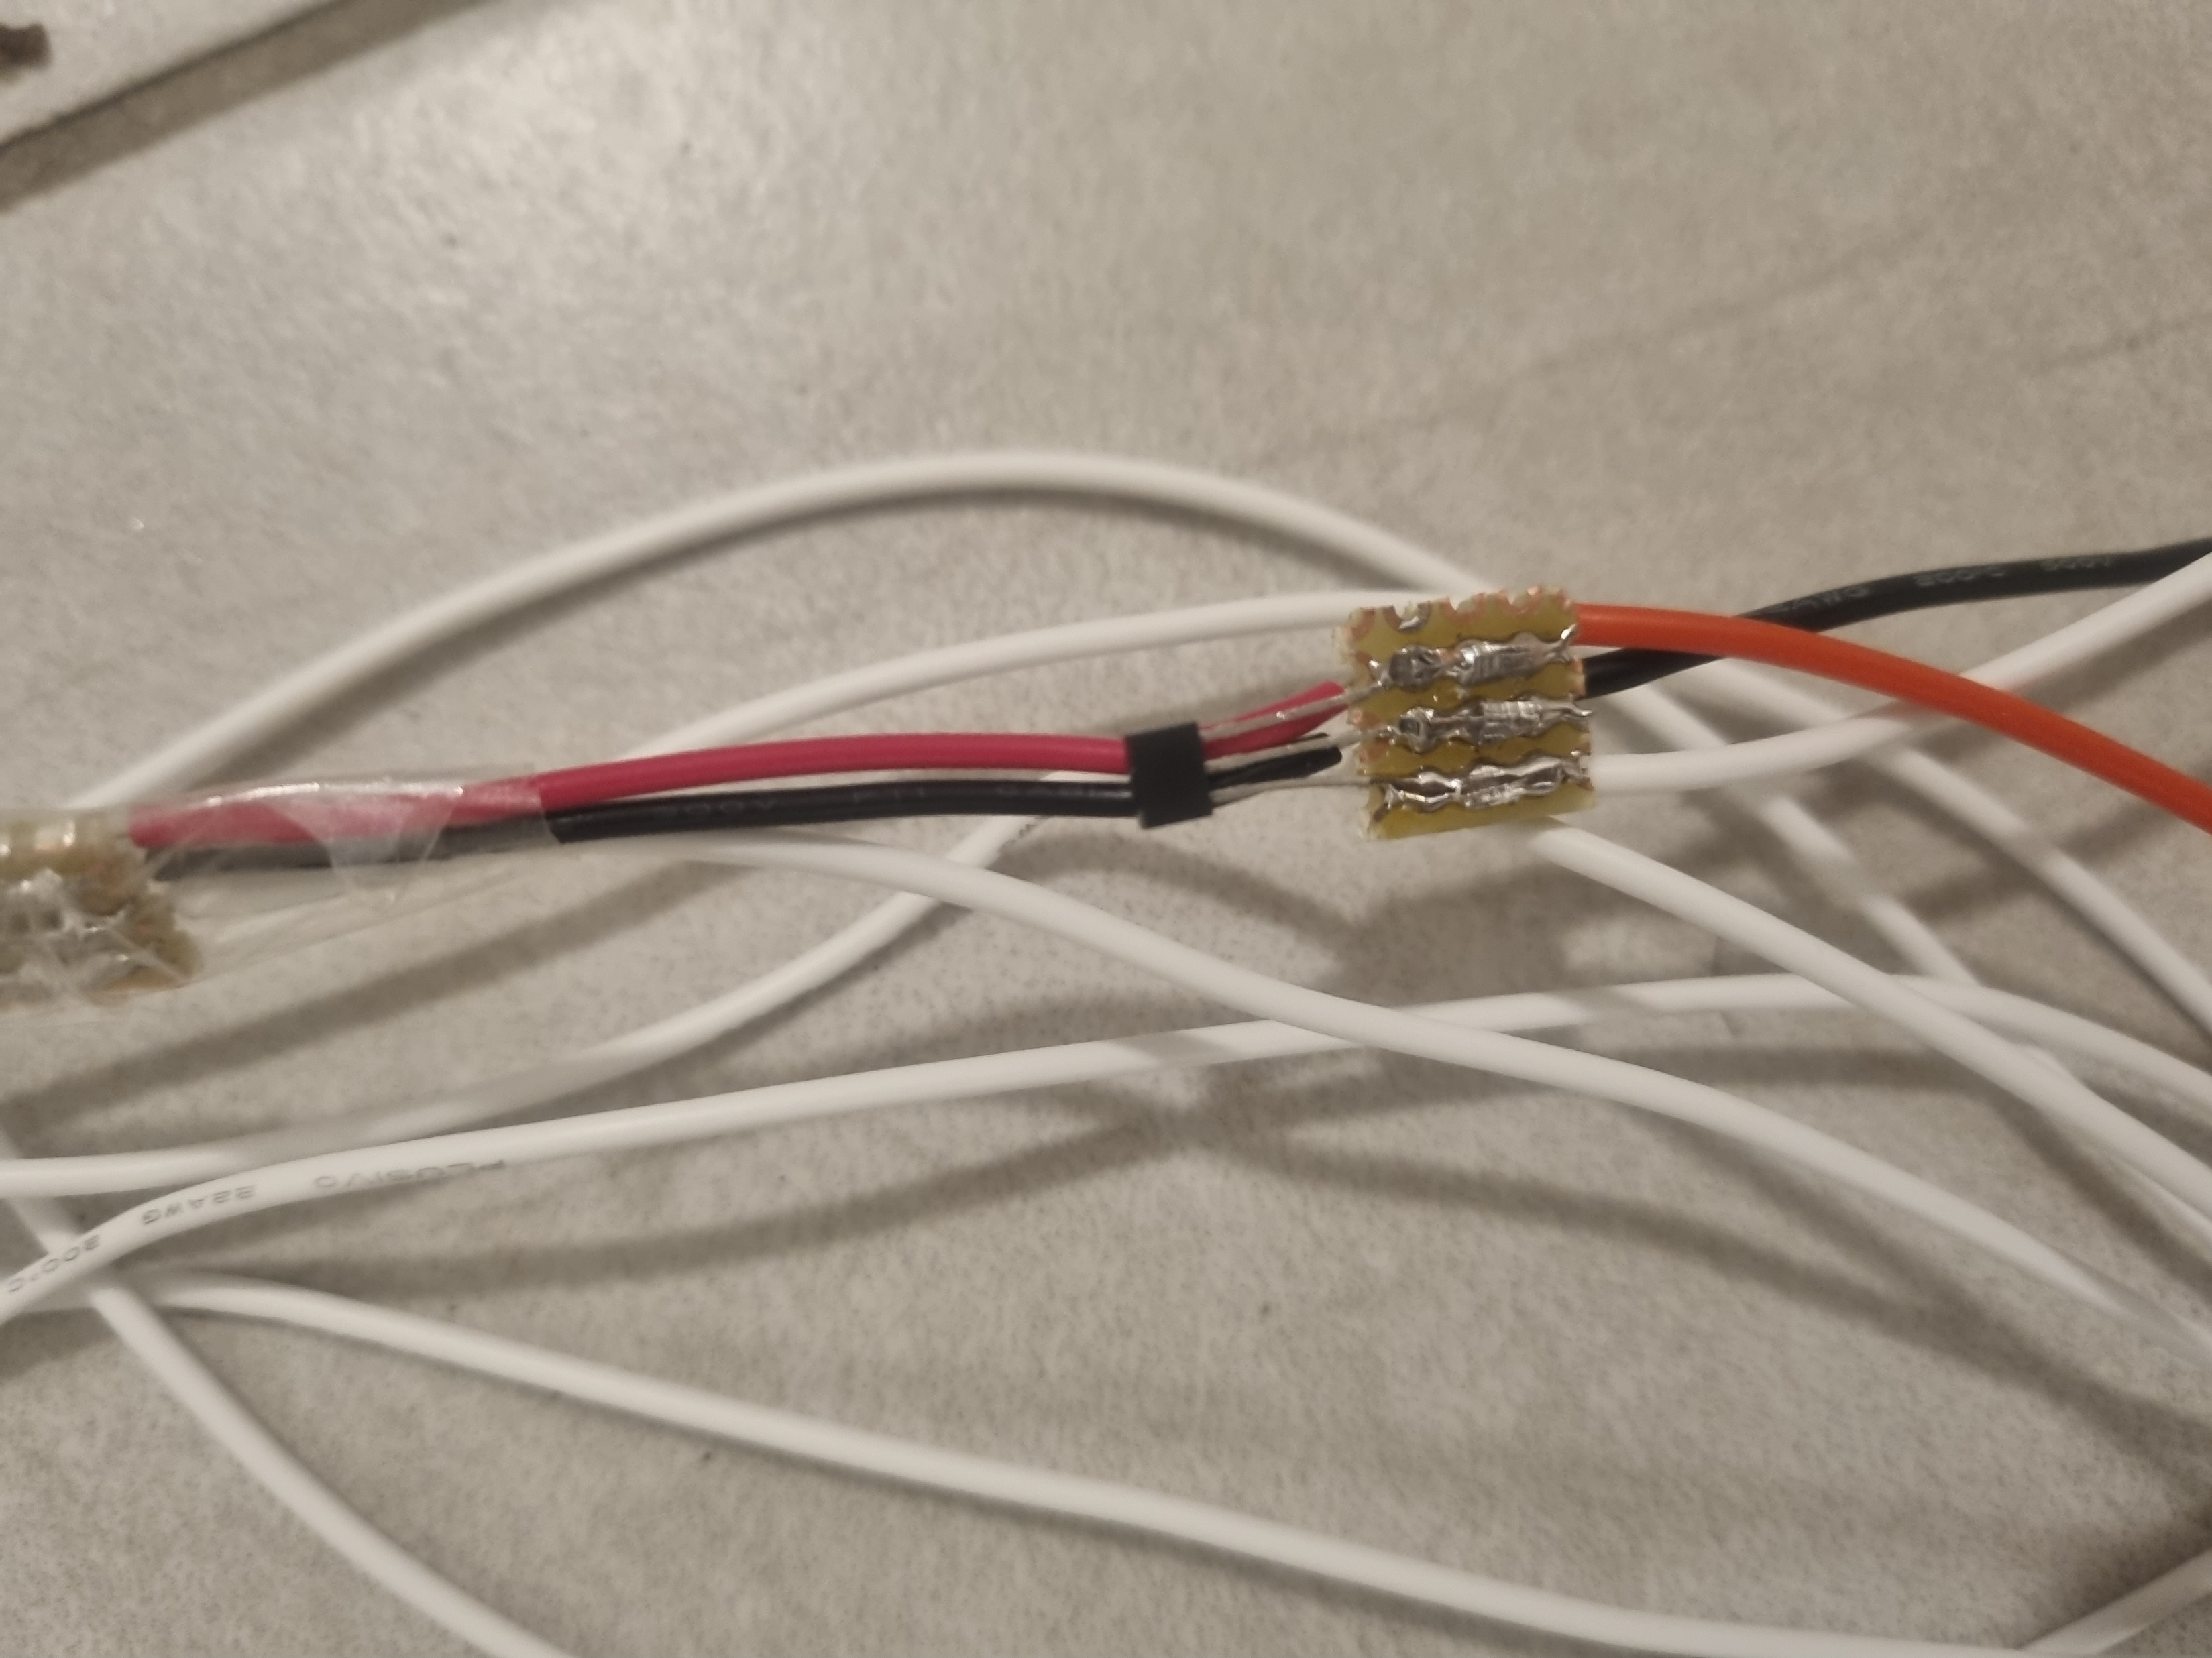
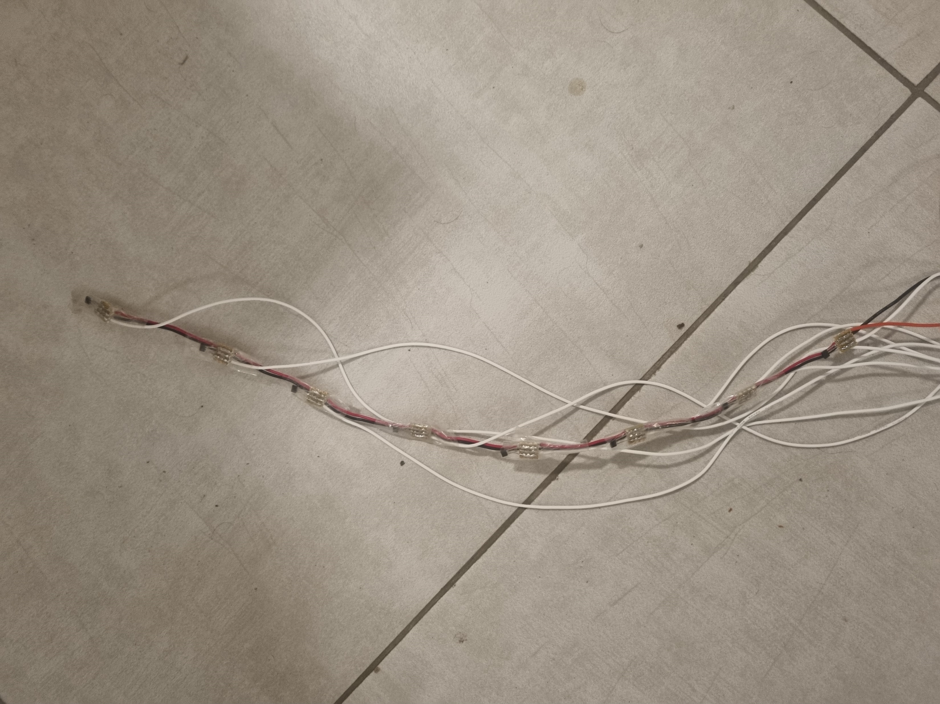
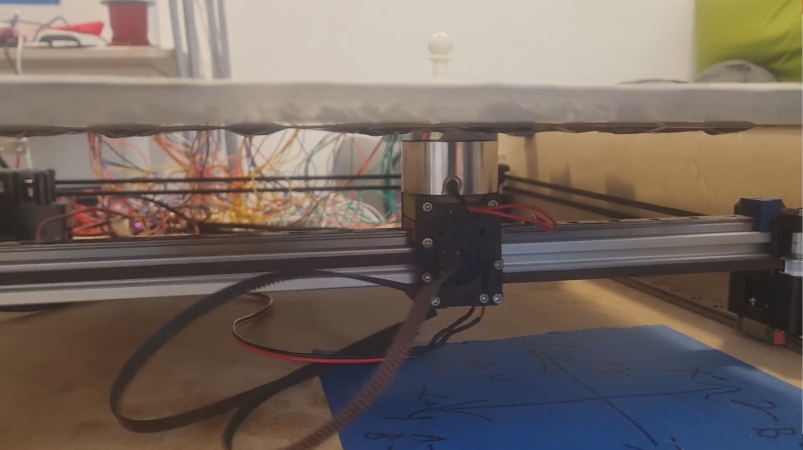
Board – Move detection
8 lines of 8 Hall effect sensors each
Pieces move detection is done by A1101 Digital Hall Effect Sensors under each square that detect the presence/absence of a magnet on that square (each piece have a magnet on the bottom).
8 Hall effect sensors
A1101 Digital Hall Effect Sensors

Slide 7
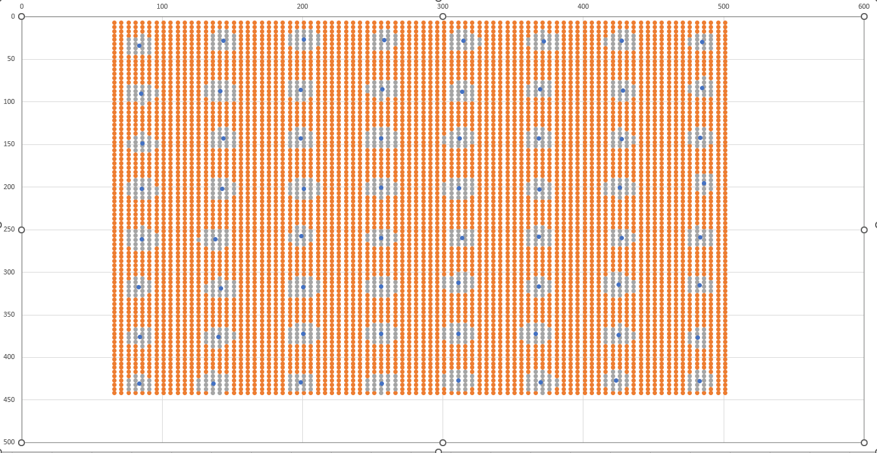
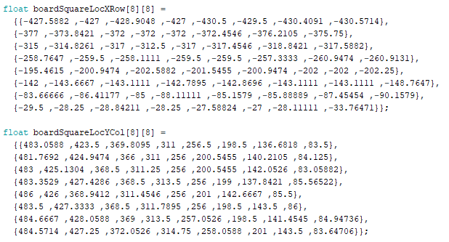
Board – Move detection
As a result of manual sensors placement , Hall effect sensors is different from board squares centers. Board calibration was done to compute exact Hall Effect sensors location.
Board calibration was done by moving the electromagnet head across the board in 5mm intervals. Hall effect sensors detection at each point was saved to draw a “detection circle” at each board square.
A center of mass equation was calculated at each “detection circle” to compute exact Hall effect sensors location.

Slide 8
Board – Move detection
As a result of lack of IO pins on the ESP32 MCU, 4 additional ESP32 board are used for IO expansion (Known as the “Client boards”).
A group of 16 hall sensors are connected to each ESP32 board (no hall sensors are connected to the Main ESP32 board), all 4 ESP32 communicate with the Main ESP32 (Known as the “Server board”) via Wi-Fi (using ESP-NOW).
ESP-NOW
ESP32 Client Board 1
GPIO connection
Hall Effect Sensors group 1
Main ESP32
(Server Board)
ESP-NOW
ESP32 Client Board 2
GPIO connection
Hall Effect Sensors group 2
ESP-NOW
GPIO connection
ESP32 Client Board 3
Hall Effect Sensors group 3
ESP-NOW
ESP32 Client Board 4
GPIO connection
Hall Effect Sensors group 4

Slide 9
Board – Board Client communication
Board Client communication is done using Bluetooth.
The board receiving commands for pieces movement (Every command is for 1 axis only and is performed as requested, without considering additional pieces that might be in the way).
Client is implementing a Shortest Path Algorithm (Dijkstra) with additional movements in the case of additional pieces in the movement path (recursive algorithm).
The board sends information about the board full state and pieces location changes (only by client request).

Slide 10
Board – Design
Full board electrical schematics can be found on GitHub (ORCAD and PDF files).
Full board 3D model can be found on GitHub (STEP and brackets 3D printer STLs files).
Full MCU (clients and server) codes can be found on GitHub (c files).

Slide 11
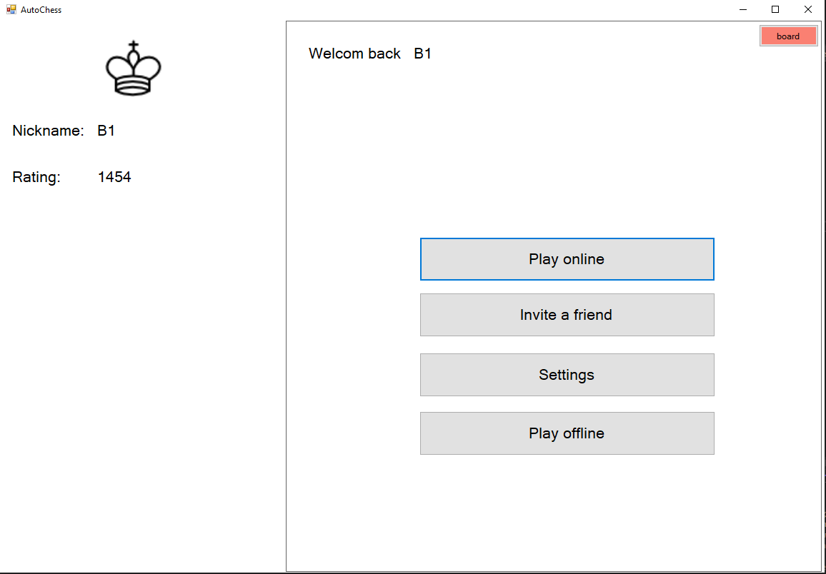
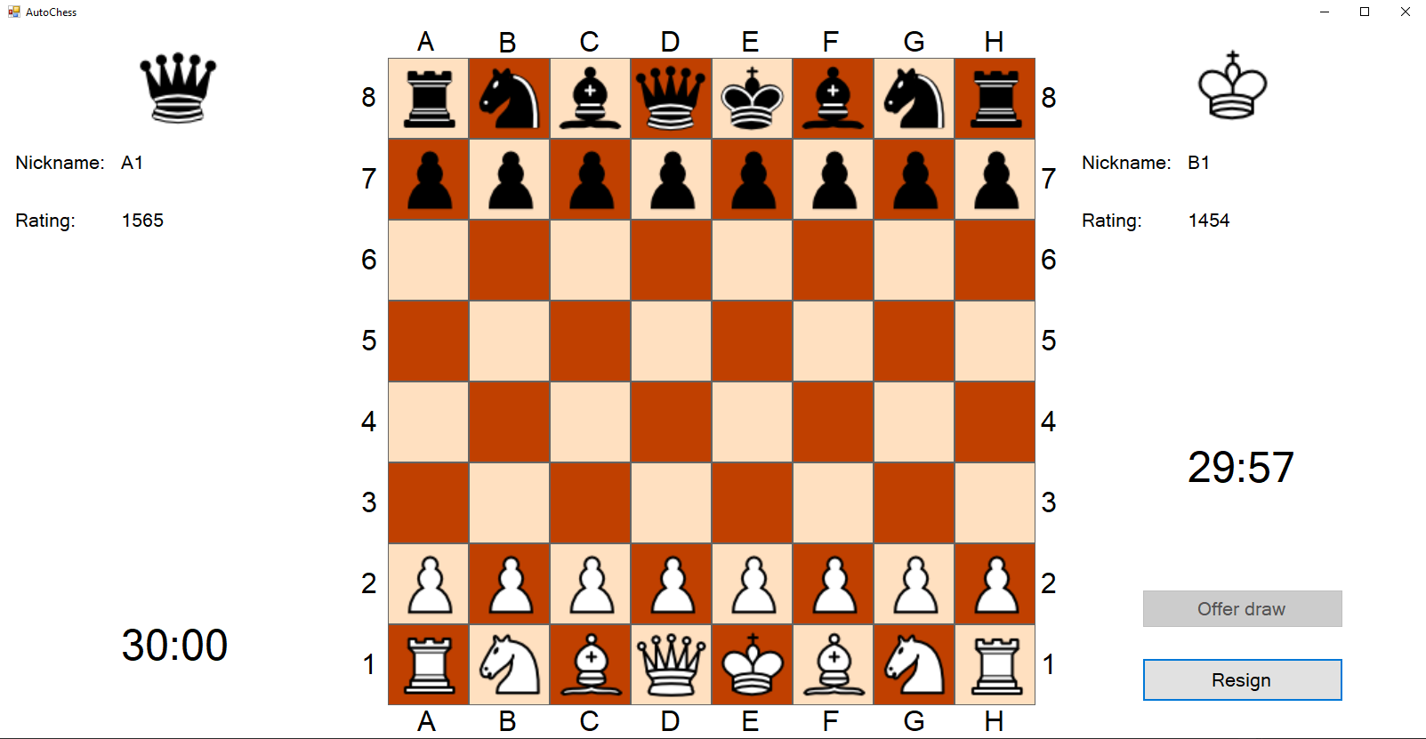
Client
Client jobs:
Full GUI.
Server communication.
Board communication and movement management.
AI implementation.
Client platform: Windows.
Client programming language: C#
Client GUI platform: Windows Forms.

Slide 12
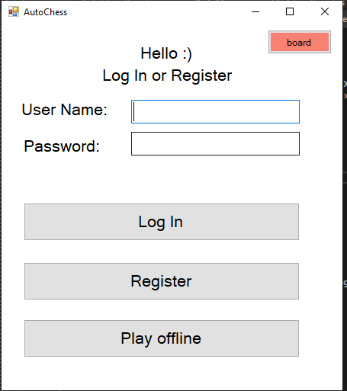
Client - GUI
Client implements a full GUI for user management.
User can use the GUI for:
Play online (vs a remote user over the internet).
Play offline (vs AI algorithm).
Register
Logging in.
Change user settings (profile pic, password, etc.)

Slide 13
Client - Server communication
Client can connect to the server using TCP/IP for playing online.
Client contain a configuration file for server IP.
All user information is stored on the server side, client is only a middleman.

Slide 14
Client - Board communication and movement management
Client can communicate with the AutoChess board using Bluetooth.
Client is mandatory for all board games.
Full game management is done by the client (board only currying out moves and report board state and changes).
Client is implementing full chess rules.
Client is implementing a Dijkstra Shortest Path Algorithm for all moves. The algorithm take into account the board state and generate the best (“cheapest”) path between the source and destination. In the case that additional pieces movement is required (piece movement is “jumping over” another pieces or the move is a capture), the algorithm generate a full path for the additional pieces as well (using a recursive algorithm).
Client send the full path movements to the board for execution (in the right order, including returning pieces that moved for “jumping over” moves).
During the user turn, client is receiving an appropriate message each time the board has changed (piece appeared/disappeared)

Slide 15
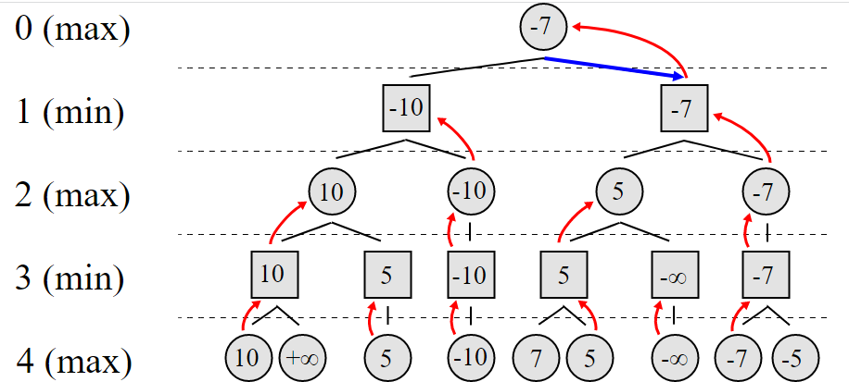
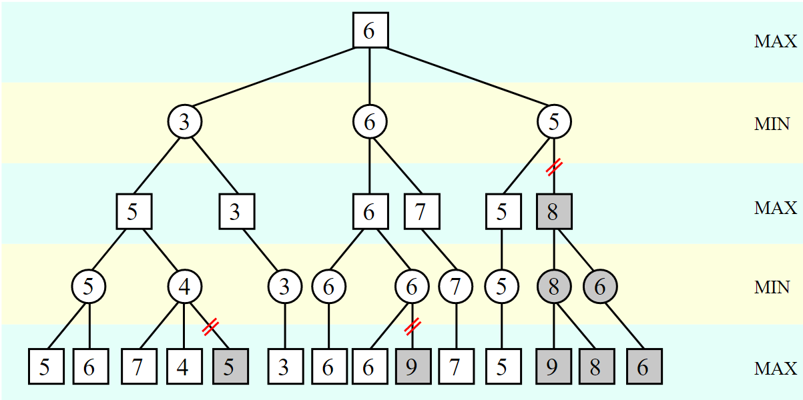
Client - AI implementation.
Client is implementing an AI algorithm for offline games.
AI is using a minimax algorithm (depth of 1 – 6 moves).
AI heuristic evaluation function is based on evaluating each side remaining pieces score (based on the piece kind) and board location.
AI is using Alpha–beta pruning algorithm for minimax optimization.
Every tree layer nodes are ordered by captured piece score (nude that not result in a capture checked last) for Alpha-beta optimization.
AI “Brain” report example can be found on GitHub.
MiniMax algorithem
Alpha–beta pruning

Slide 16
Client - Design
Full Client codes can be found on GitHub
AI “Brain” report example can be found on GitHub.

Slide 17
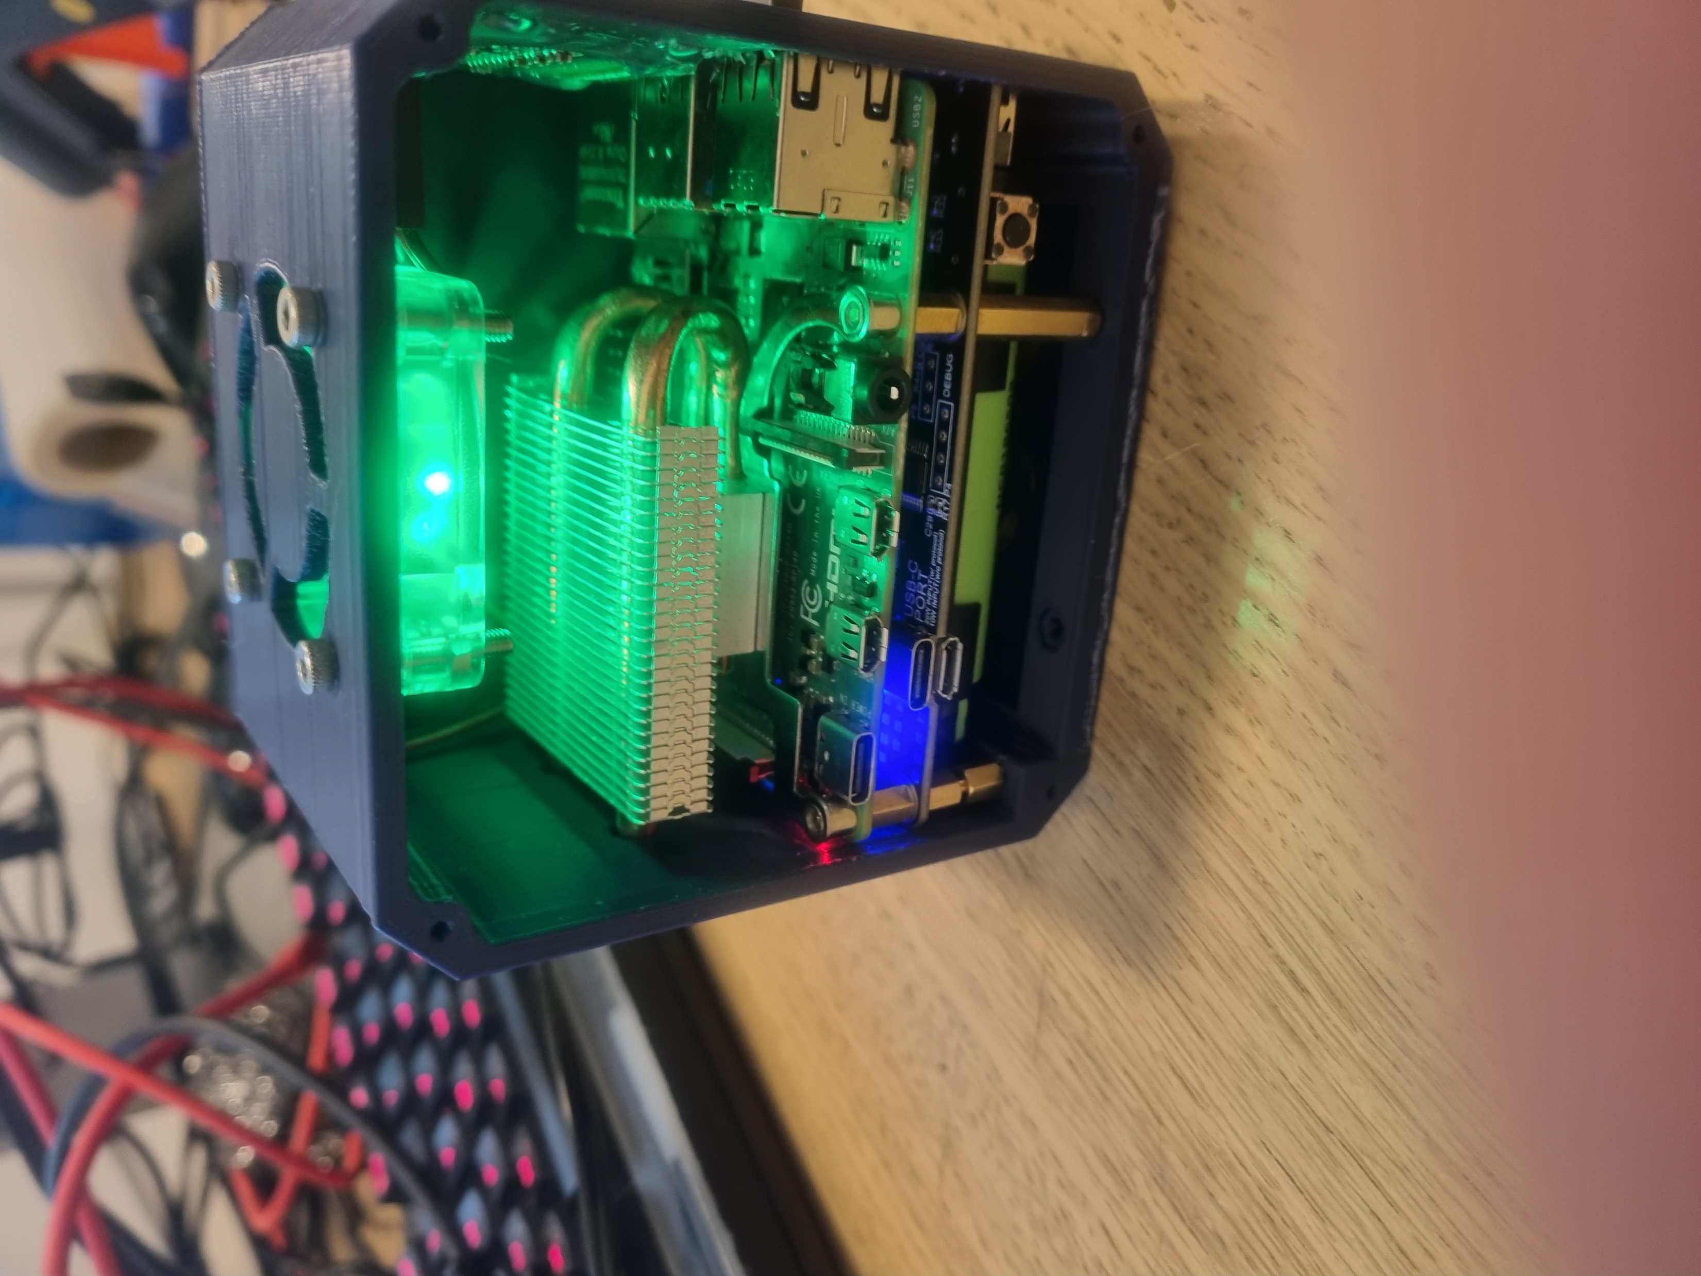
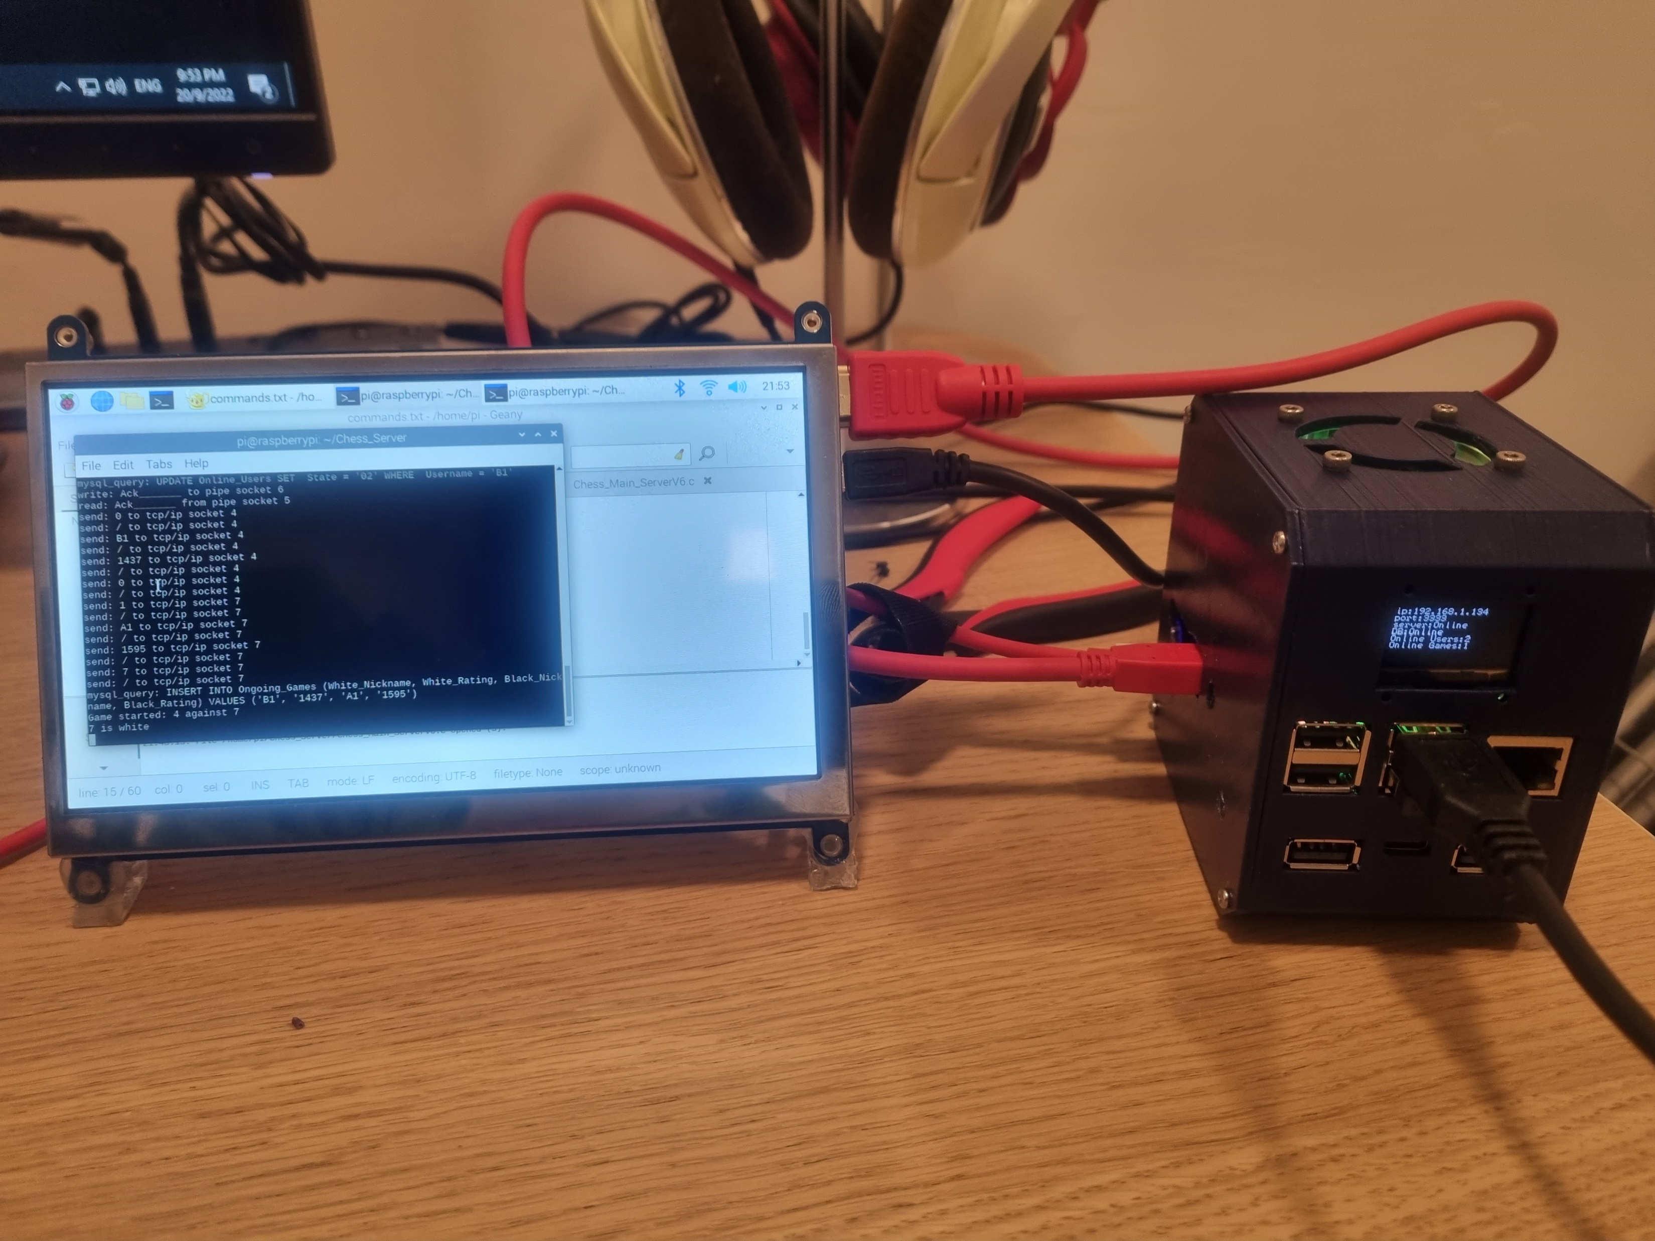
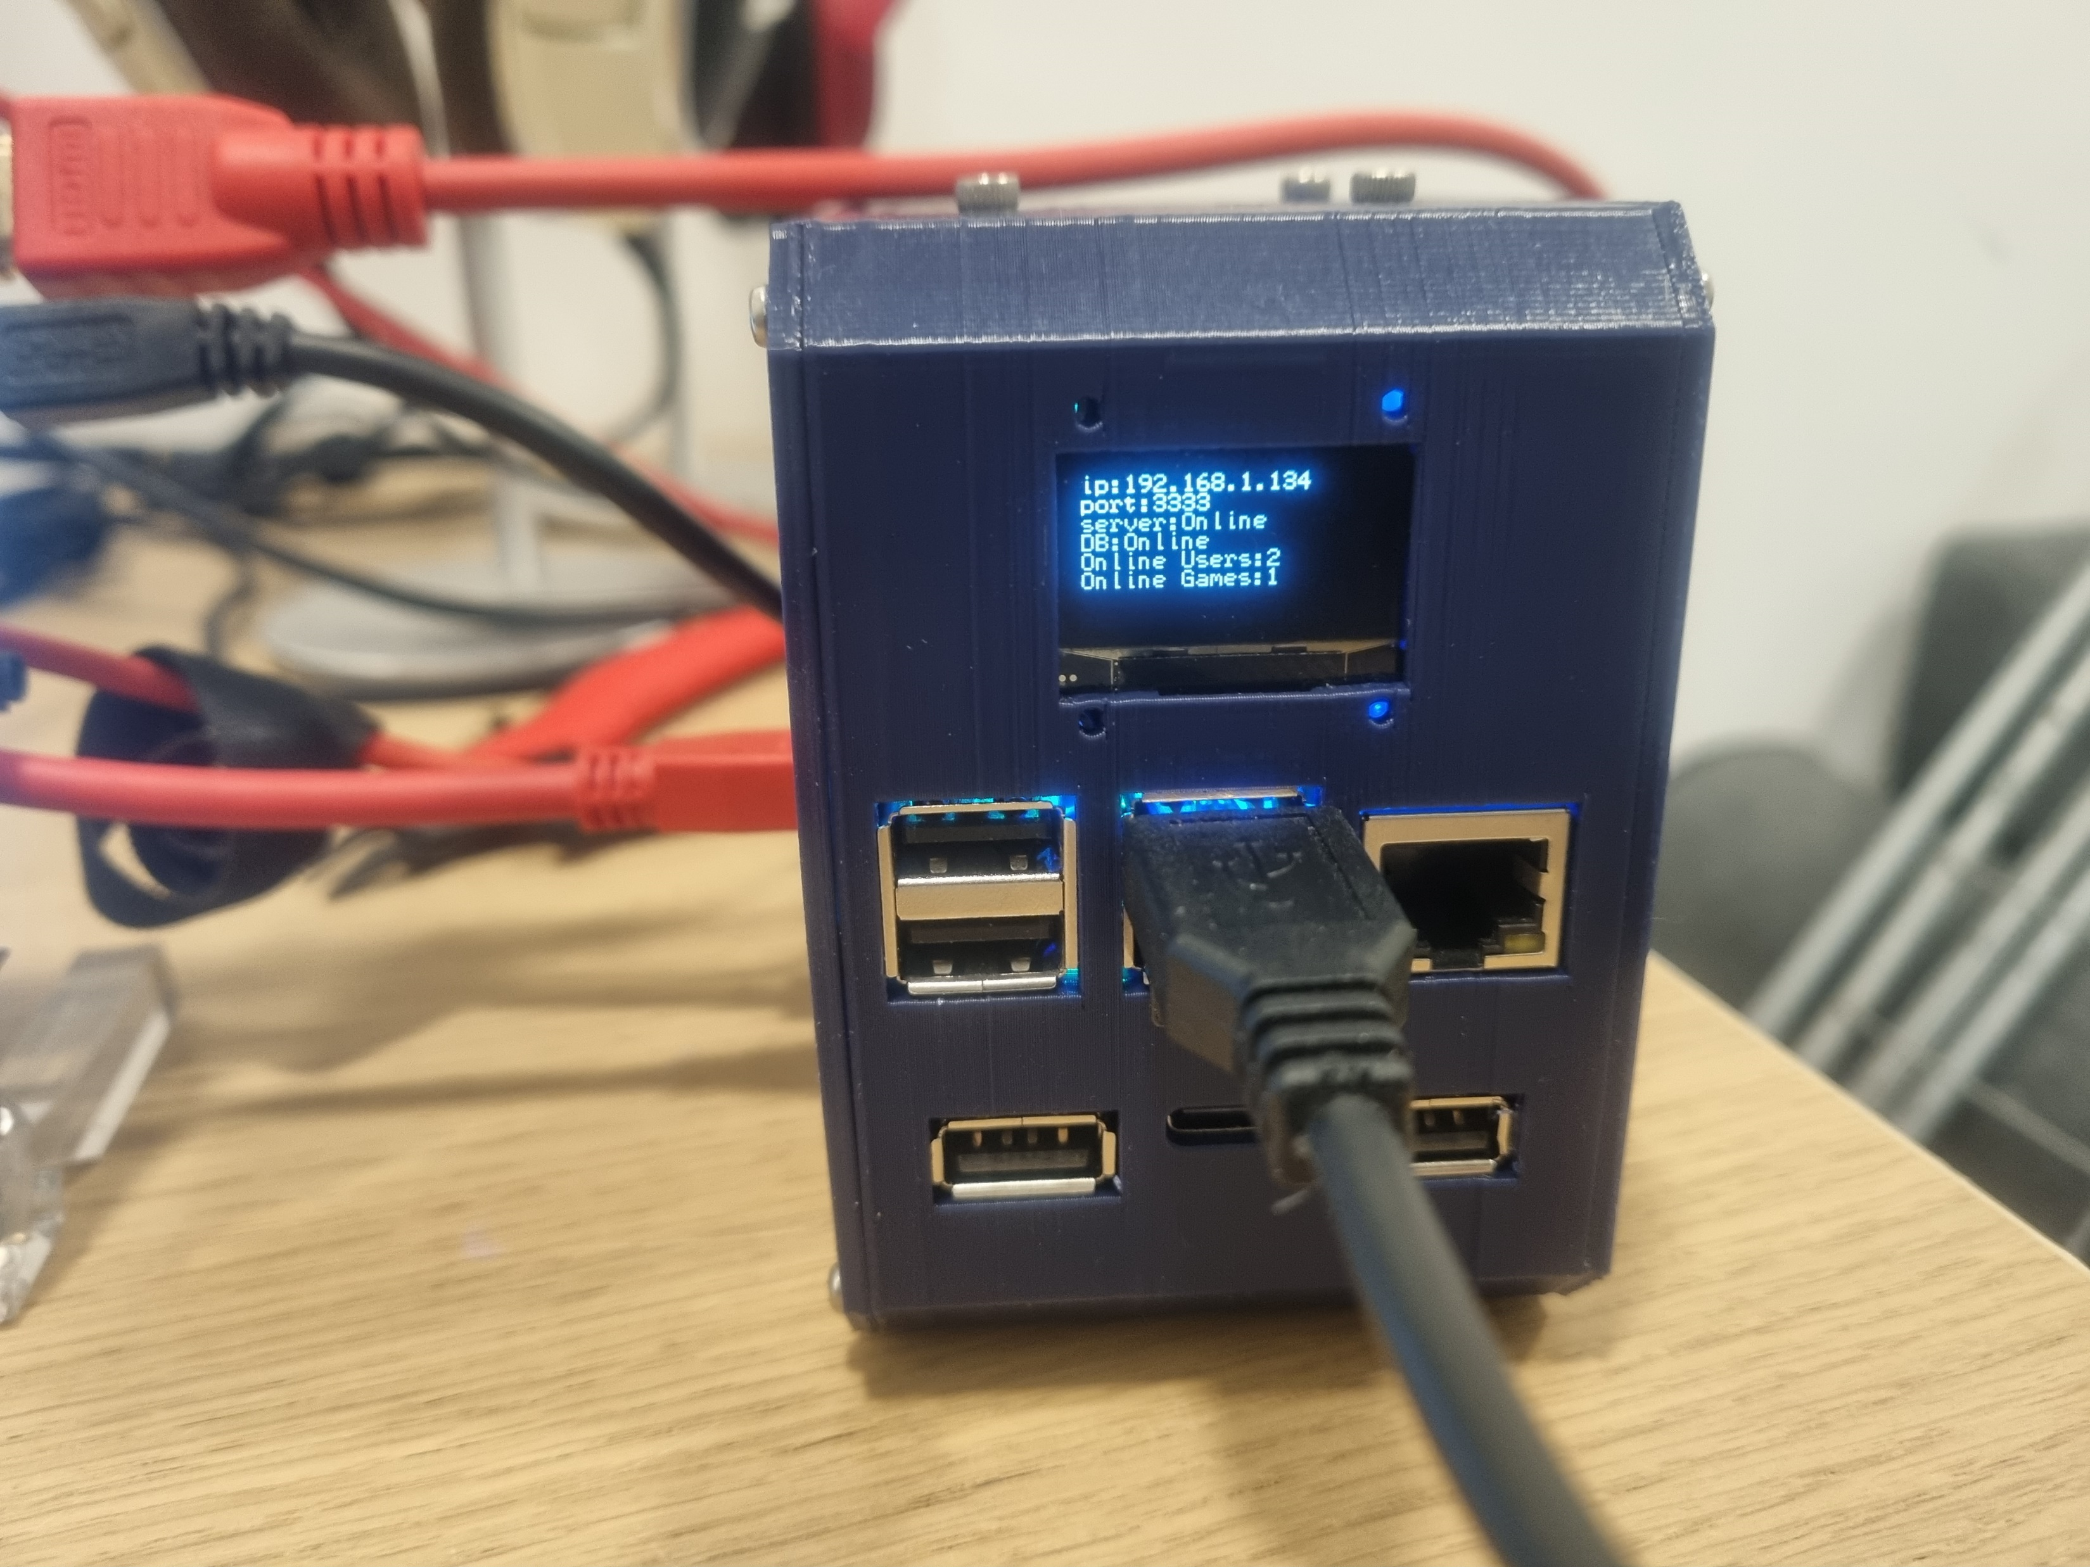
Server
Server jobs:
Users management.
Clients management.
Game management.
Server platform: Raspberry Pi.
Server programming language: C.
Server DB platform: MySQL.

Slide 18
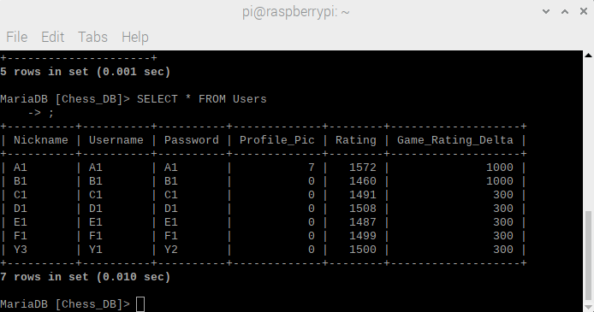
Server - Users management
Server contains User DB.
Each User have: Username, Password, Nickname, Profile pic, Rating, Online game rating delta.
All users information is stored in MySQL DB running on the same machine.

Slide 19
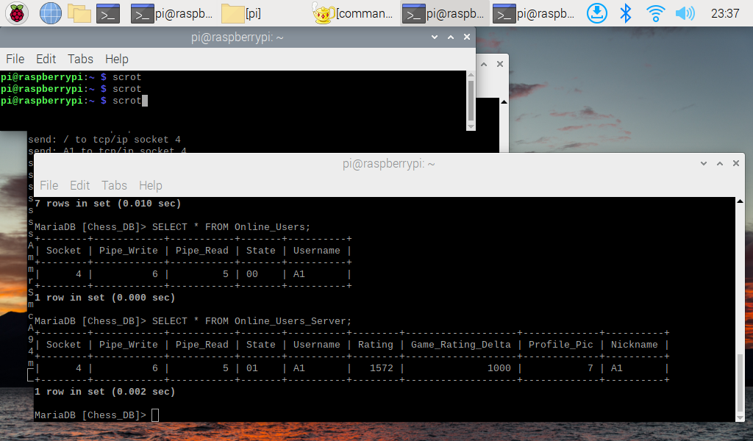
Server – Clients management.
Server clients management is done by a multithreaded design.
Clients need to log in (or register) before a game can be played.
Server keeps track of online users using a relevant DB table.
Clients can change the user settings (nickname, password, etc.)
Server keeps track on “waiting for game” clients using a relevant DB table, when 2 suitable clients are waiting for game, the server start a game and manage the communication between the 2 sides (using a single thread).
Clients can invite an online friend for a friendly game.

Slide 20
Server - Game management.
Server is implementing full chess game rules (using a custom-made Chess API).
Server accepts only legal moves from the clients (including special moves like en passant, castling, promotions).
Server keeps track of each game and notify the clients on the winner and loser.
Server updates the users chess ratings after game ends.
The game is managed by a single thread, the other client thread is on “stand by” until the game ends.

Slide 21
Server - Design
Full Server codes can be found on GitHub.

Slide 22
Thank you

